Slide 1

NBA Salary Prediction
Using Linear Regression
Jason Zhang
1/21/2021

Slide 2
Purpose
“The goal is to predict NBA player’s salary based on NBA Player’s Stats.”

Slide 3
Background
Founded in 1946
30 Teams Total
82 Games per Season
~500 Players
Average Salary: $7.9MM

Slide 4
Method
Data Preparation
Feature Engineering
Model-
Validation & Selection
Model -
Result & Evaluation
Web Scraping
Data Cleaning
Creating Features
Pearson R^2 Correlation
Multicollinearity
Assumptions for LM
Linear Regression
K-Fold Cross Validation
Regularization: Lasso & Ridge
Final Output LM
R^2
Residual

Slide 5
About the Data
Source: basketball-reference.com
NBA Player’s Statistics Data
Time Frame: 2019-20 NBA Season
NBA Player’s Salary Data
Time Frame: 2020-21 NBA Season
Final Sample Size: 479

Slide 6
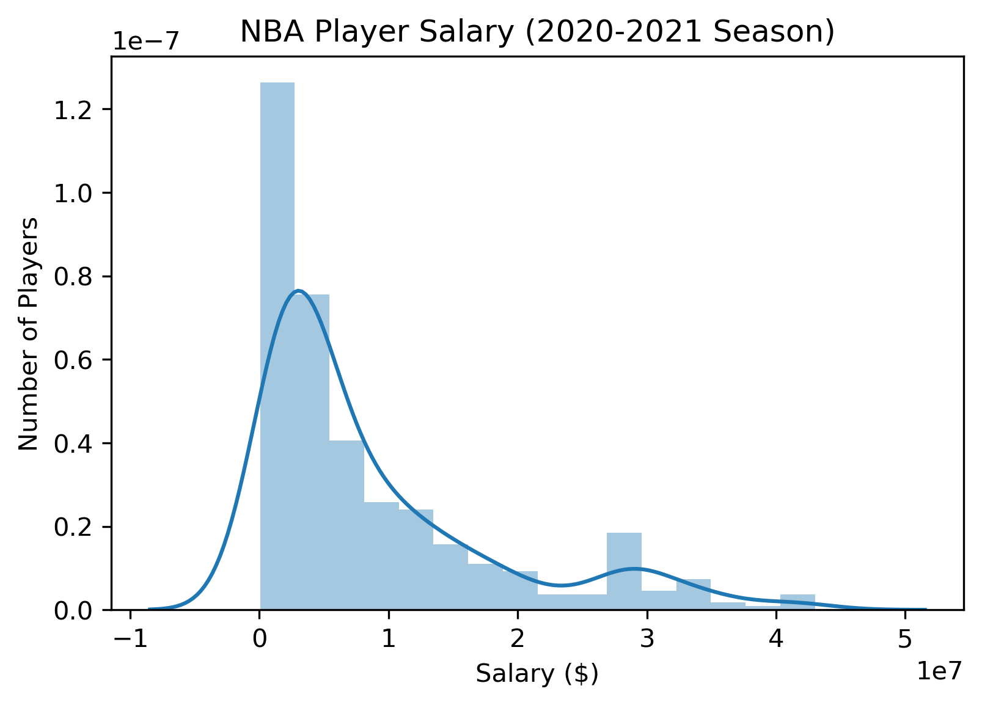
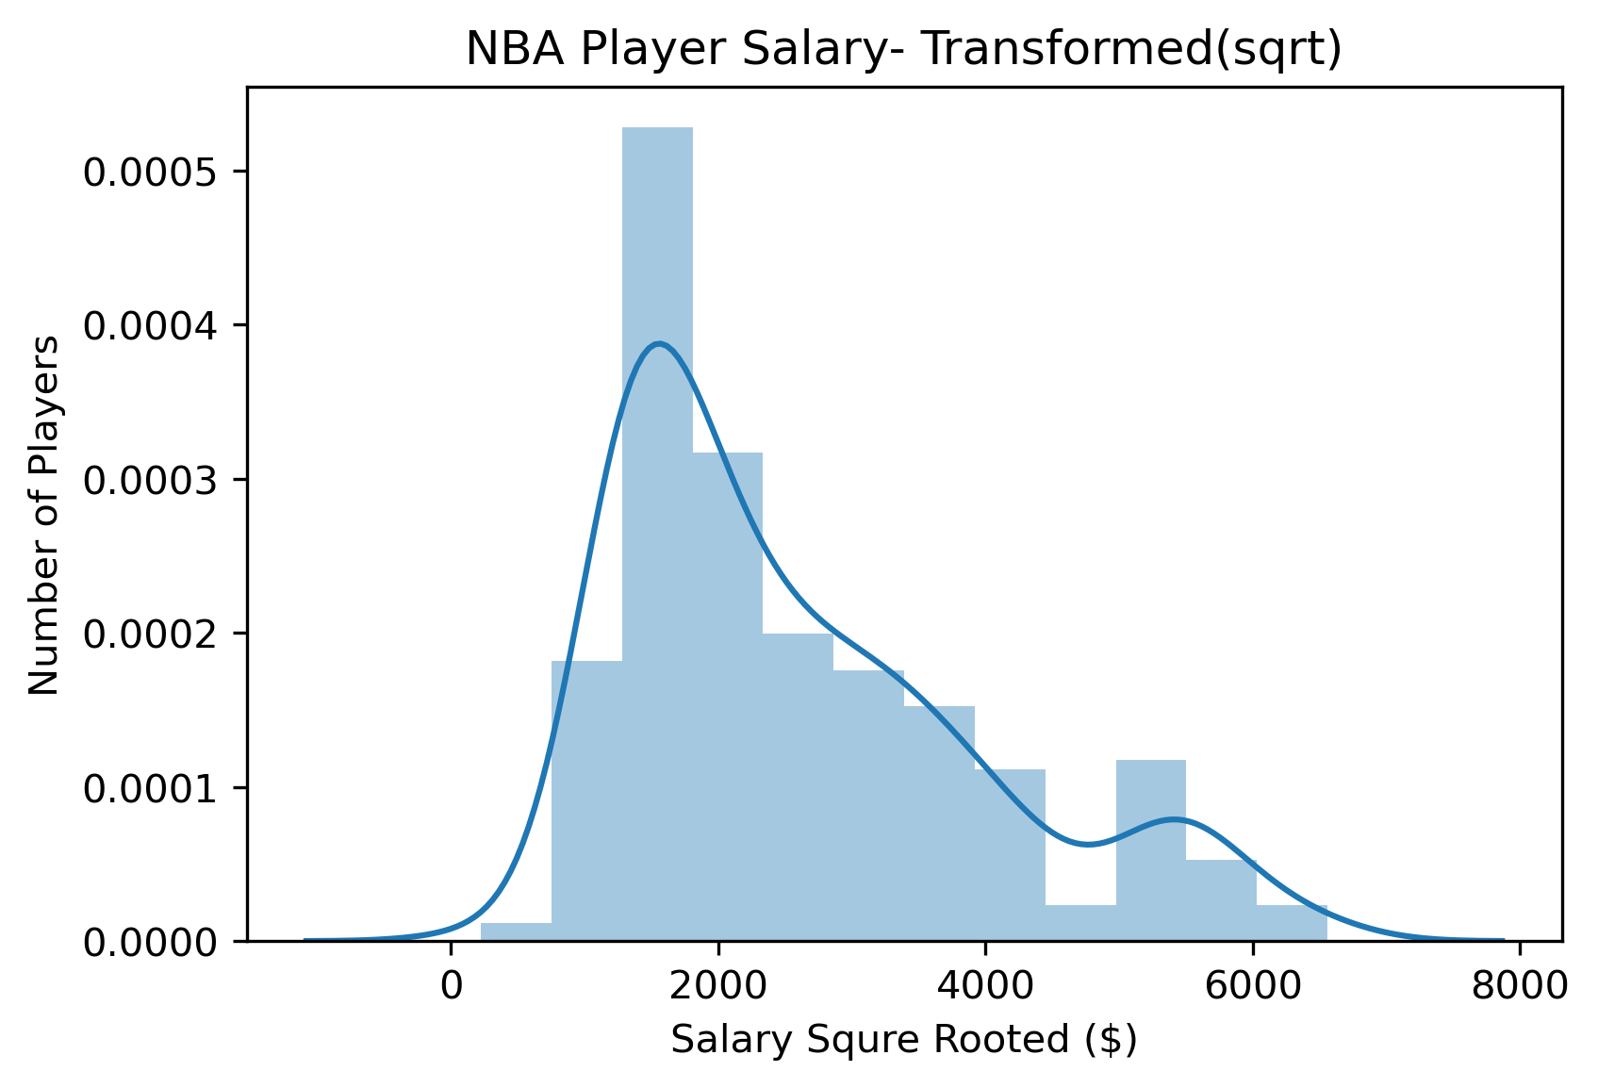
Feature Engineering
Transform “Salary” to normal distribution by using sqrt of “Salary”

Slide 7
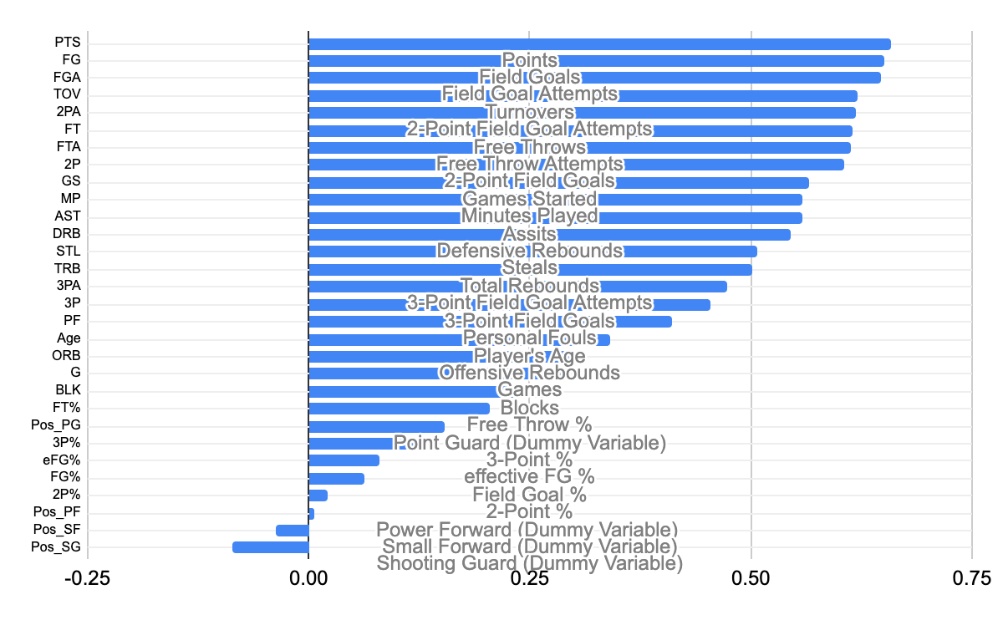
Feature Engineering - Pearson Correlation
Many features has high correlation with sqrt(Salary)
“Position” features has low correlation with “sqrt(Salary)”

Slide 8
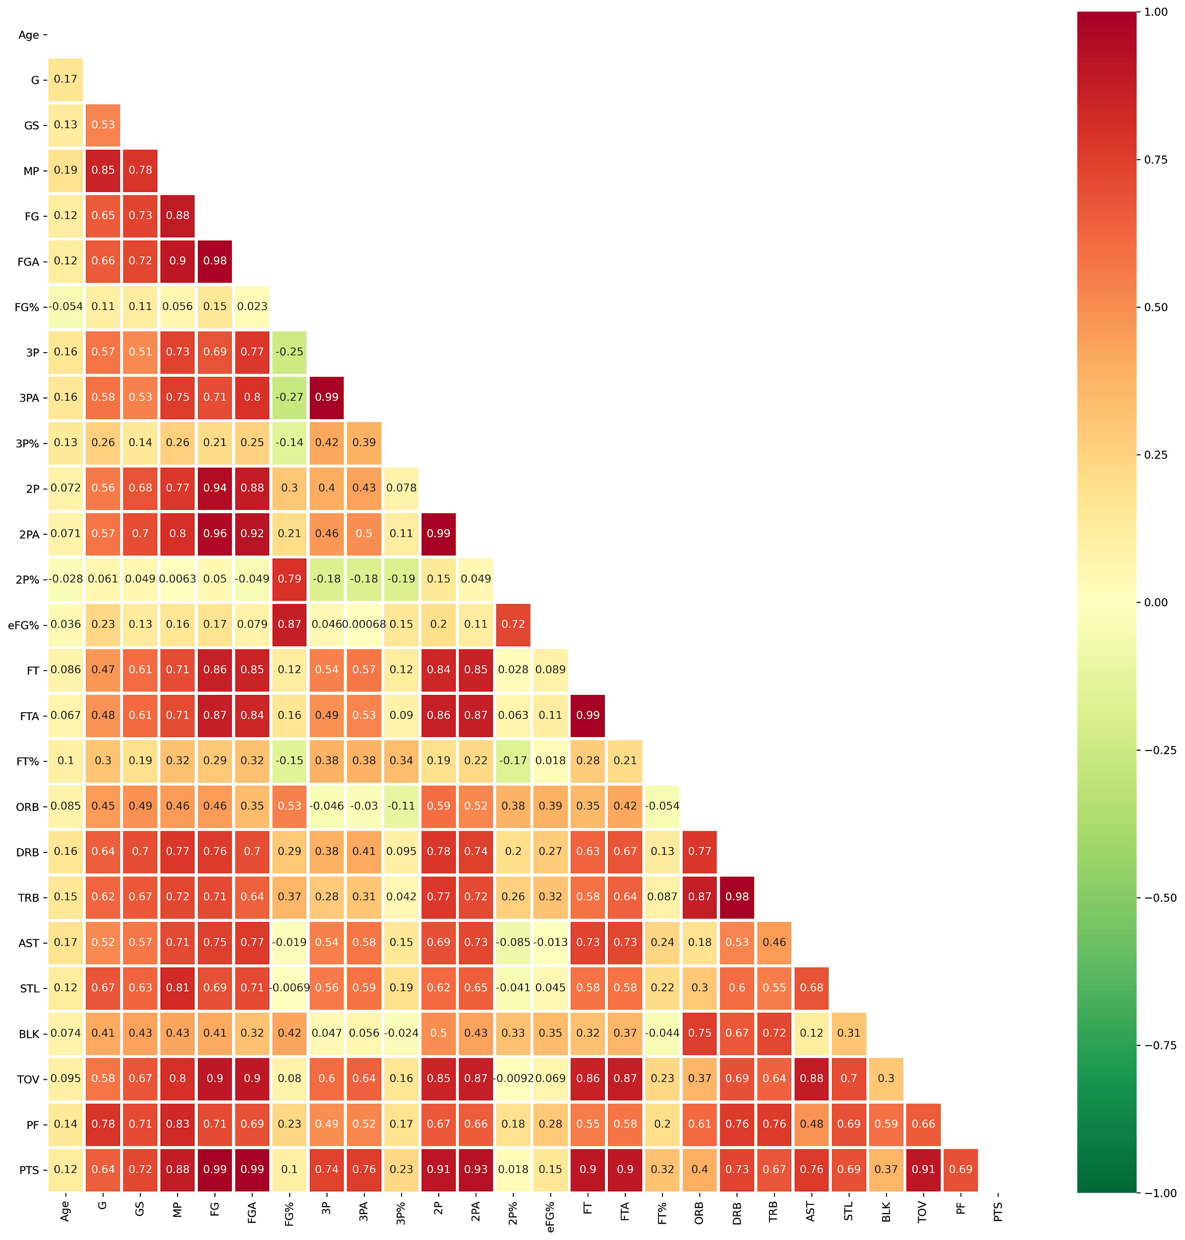
Feature Engineering - Multicollinearity
high multicollinearity between many variables

Slide 9
Model - Linear Regression
Initial LR Model - fit all numeric features
Result (CV=5):
R^2 - Train: 0.613
R^2 - Test: 0.490
Model too complex and it’s overfitting

Slide 10
Model - Regularization (LassoCV)
Standardized Features
Used LassoCV to solve overfitting and reduce complexity.
 | Before Lasso CV | After Lasso CV
Variables | 26 | 14
R^2 | 0.490 | 0.510

Slide 11
Model - Final Predictors & Result
Variables | Description | Coefficients
PTS | Points | 625.29
Age | Player's Age | 300.13
GS | Games Started | 188.21
STL | Steals | 151.74
AST | Assists | 145.04
TRB | Total Rebounds | 80.26
FGA | Field Goal Attempts | 67.26
FT% | Free Throws% | 57.58
3PA | 3-Point Field Goals Attempts | 49.65
ORB | Offensive Rebounds | 33.89
BLK | Blocks | 27.32
FG | Field Goals | 16.07
2P% | 2-Point % | 1.81
PF | Personal Fouls | -52.38
G | Games | -430.89

Slide 12
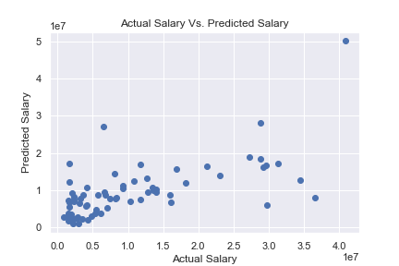
Model Evaluation -Prediction vs. Actual
RMSE = 1,053,417
Unit = $US Dollars

Slide 13
Future Work
Add more features
Collect historical data & Adjust Inflation
Fine-tuning model with more possible algorithms
Notes:
Features such a Draft Rank, Contract Type, Championships, Injuries

Slide 14
Questions?

Slide 15
Appendix
NBA Player Stats Data:
https://www.basketball-reference.com/leagues/NBA_2020_totals.html
NBA Salary Data:
https://www.basketball-reference.com/contracts/players.html

Slide 16
Appendix
Python Packages Used
requests
urlopen
BeautifulSoup
pandas
numpy
seaborn
matplotlib
sklearn

Slide 17
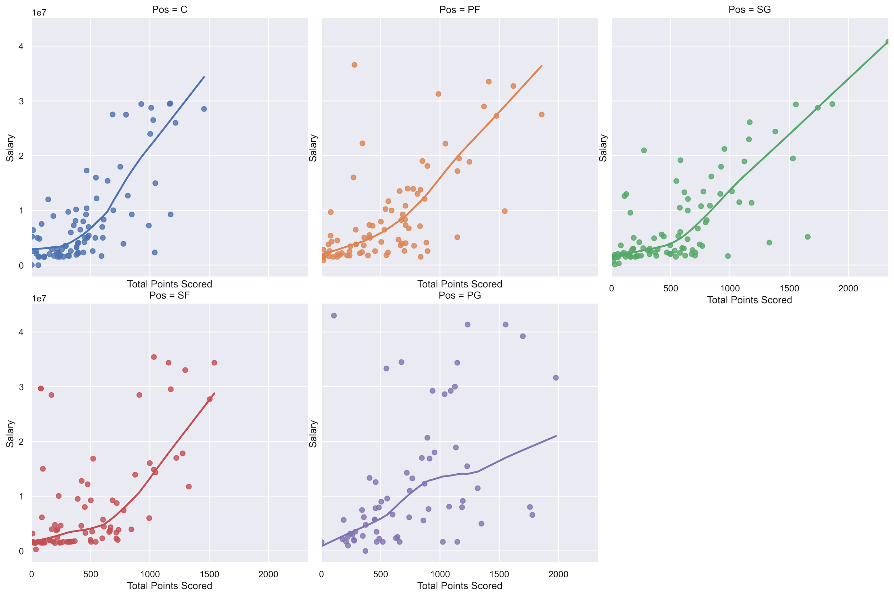
Appendix
Salary vs. PTS by Position

Slide 18
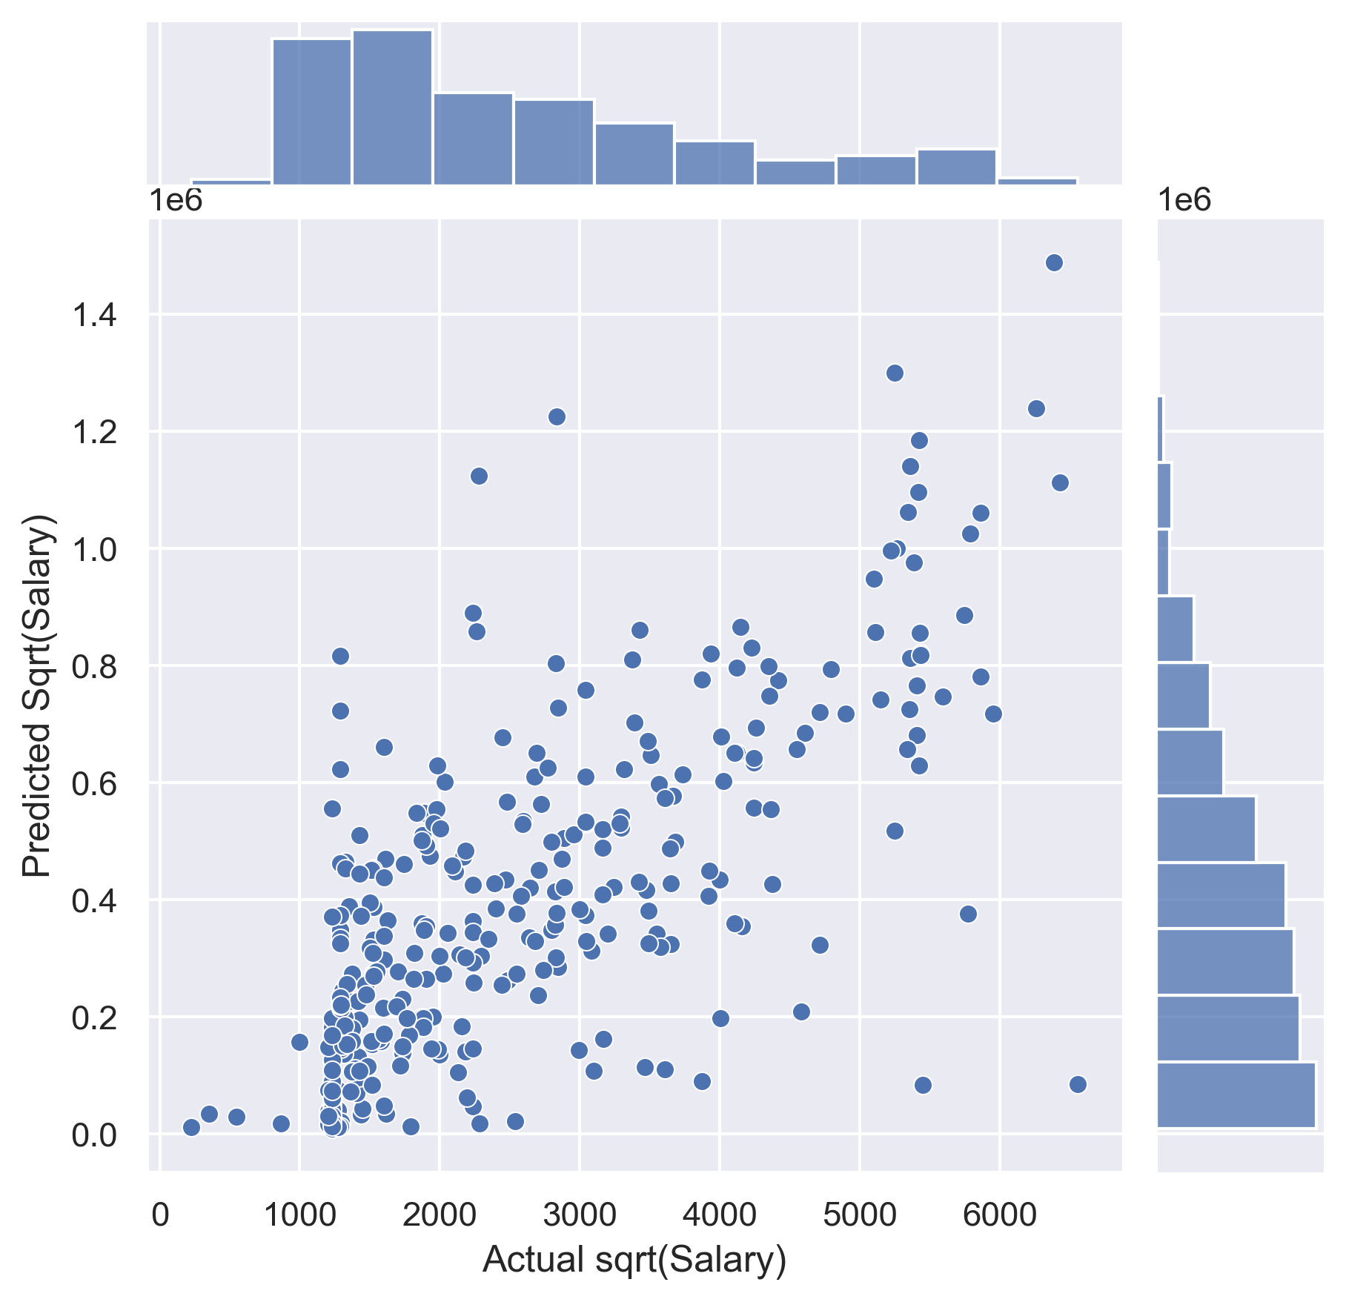
Appendix
Residual Plot for LassoCV - sqrt(Salary)

Slide 19
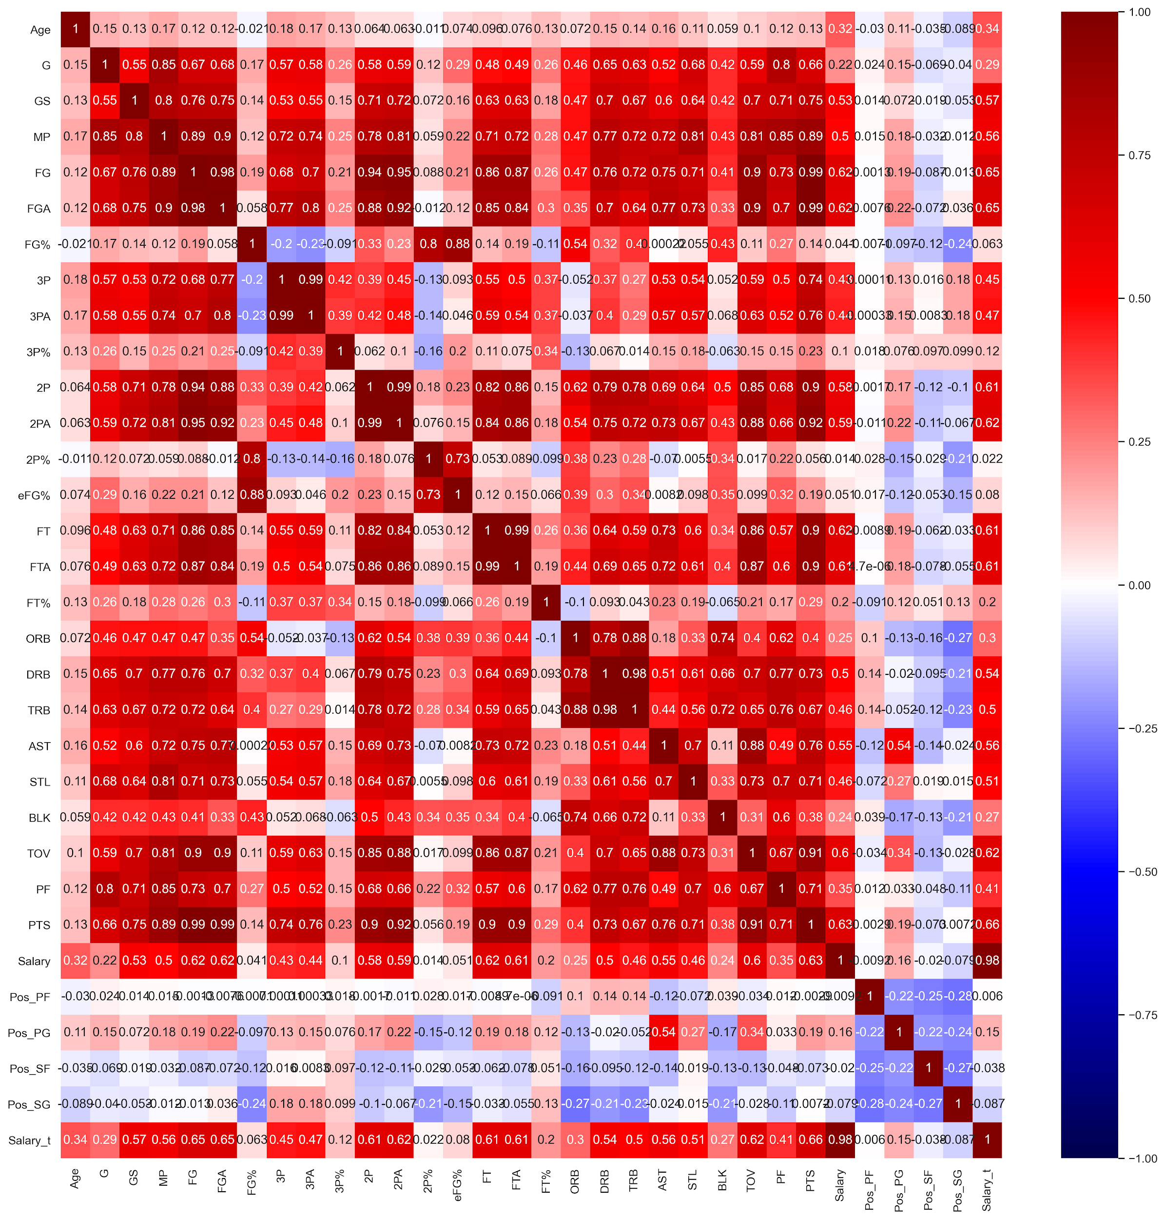
Appendix
Correlation Heatmap

